Slide 1
Python programming basics

Slide 2
Python Fundamentals
In this chapter you'll learn about:
Python in Visual Studio
Basic statements
Numbers, strings and Boolean variables
Keyboard input. Screen output.
Casting

Slide 3
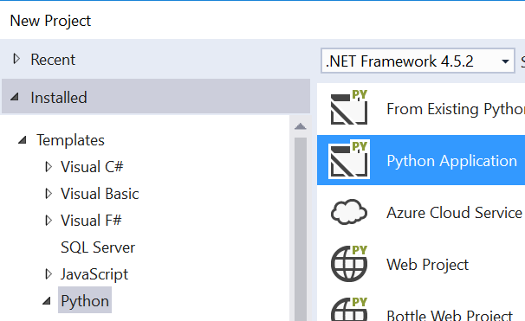

Why Visual Studio?
Is a superb development environment
Excellent debugging and testing facilities
There are many online compilers
https://repl.it/languages/python3

Slide 4

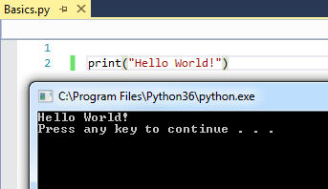
Printing to Console window
print ('Hello World')
Click or F5 key to run
press Ctrl-F5 to run without debugging

Slide 5
Comments in code
Help readers understand your code
Use a # to ignore the following chars
Are ignored when code runs
# process user information
print('Hello World!') # display greetings

Slide 6
Data Types in Python
There are three basic variable types
Numbers: Integer and Float
1,2,3, 1.23, 0.0005
Character or String
'Hello world' or "Hello world"
Boolean True or False (case-sensitive)
age=21
salary = 2000.78
companyName='QA Ltd'
isRegistered = True
hasLicence = False
type is determined automatically.
value can change.
Notes:
The best way to learn to code is to actually write the code yourself. You should do your best to follow along, writing code with me during the presentation. Example code is available in the Files section of Canvas.
You do need to know the basics of how programs work. They rely on commands and the data that the commands operate on. Data can be literals, i.e. actual numbers or pieces of text, held in variables.

Slide 7


Variables naming standards
Use letters not punctuations
No 'reserved word'
salay$ = 1500
my-city='London'
my city='London
my_city='London'
myCity='London'
print = 10
Notes:
A Python identifier is a name used to identify a variable, function, class, module or other object (more on functions, classes & modules later). An identifier starts with a letter A to Z or a to z or an underscore (_) followed by zero or more letters, underscores and digits (0 to 9).
Python does not allow punctuation characters such as @, $, and % within identifiers. Like most (but not all) programming languages, Python is case sensitive so Manpower and manpower are two different identifiers in Python.

Slide 8
Variables naming standards
Case sensitive
Use lowercase letters for consistency
What will be displayed?
age=32
Age=21
print(age)
32
Notes:
A Python identifier is a name used to identify a variable, function, class, module or other object (more on functions, classes & modules later). An identifier starts with a letter A to Z or a to z or an underscore (_) followed by zero or more letters, underscores and digits (0 to 9).
Python does not allow punctuation characters such as @, $, and % within identifiers. Like most (but not all) programming languages, Python is case sensitive so Manpower and manpower are two different identifiers in Python.

Slide 9

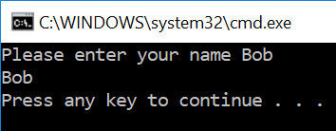
User input using keyboard
Input with a prompt input(<prompt>)
name = input('Please enter your name ')
print(name)
Notes:
Python in Visual Studio does not have the interactive command mode of the IDLE editor so we must run every line of code as a program. This is not normally an issue.
This does mean that we need to output program results to see what has happened. For this we use the Visual Studio output window.
Our input device is the keyboard. In this lesson we will see how to use both these devices.

Slide 10

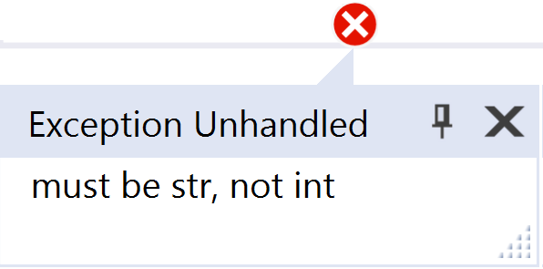
Putting strings together
username = 'Bob'
print('Hello' , username)
print('Hello' + username)
print('Hello ' + username)
Hello Bob
HelloBob
Hello Bob
Cannot add numbers and strings
age = 21
print('Your age is ' + age)
Message = 'Your age is ' + age
keyboard input is always text… even if it 'looks' like a number
age = input('Please enter your age ')
age = age + 1

Slide 11

Casting
keyboard is text so we use casting to convert it to other types
age = int(input('What is your age? '))
age = age + 1
print('Next year you will be', age ,'years old')
What is your age? 21
Next year you will be 22 years old
age = input('What is your age? ')
age = int(age)
age = age + 1
print('Next year you will be', age ,'years old')
Notes:
Te slide shows two methods of casting. The first example is more common.

Slide 12
Casting a number to string
Use the str() function
## Find the average of a few numbers
total = 1 + 3 + 5 + 7 + 9 + 11
average = total / 6
print("Total is = " + str(total))
print("Average is = " + str(average))

Slide 13
Casting floats
price = int(input('What is the price? '))
totalPrice = price * 1.2
price = float(input('What is the price? '))
totalPrice = price * 1.2
Notes:
Integers cannot take part in float operations. Cast to float to perform such operation as seen on the slide.

Slide 14
Lab
In this lab you will write code to:
Edit code in Visual Studio
Compile and run your code
Input values into variables
Lab duration: 30 minutes
02-Python Programming basics Lab.docx

Slide 15
Summary
In this chapter you learned about:
Python in Visual Studio
Basic statements
Numbers, strings and Boolean variables
Keyboard input. Screen output.
Casting

Slide 16
Further Reading
https://www.python.org/
https://www.python.org/dev/peps/pep-0008/#a-foolish-consistency-is-the-hobgoblin-of-little-minds

